Slide 1
Cambridge TECHNICALS- LEVEL 3
Unit 11 – Accounting Concepts 2016 Specification - H/507/8158
LO4 - Know What Benefits Branding Can Generate For Businesses

Slide 2
Calculating the Points
e
The number of points available for each unit depends on the unit grade achieved. Units 1 and 22 in the Cambridge Technicals in Business are 120 GLH; all other units are 60 GLH. The table below shows the number of points issued for each grade.
To calculate the learner’s qualification grade you will need to add up all the points for the units the learner has achieved, making sure they’ve covered the appropriate mandatory content, taken sufficient externally assessed units, and any units required for the chosen pathway.
Unit GLH | Points table for units based on GLH
 | Pass | Merit | Distinction | Unclassified
60 | 14 | 16 | 18 | 0
120 | 28 | 32 | 36 | 0

Slide 3
Qualification Grade Table - Diploma
e
Having calculated the total number of points based on the unit grades you would check this figure in the qualification grade table, for the relevant qualification, to identify the overall qualification grade. If a learner doesn’t achieve the lowest points score required for the qualification, we issue an unclassified result.
Example A
Learner A has taken the units required for the Foundation Diploma:
In this example, Learner A has an overall qualification grade of a Merit Merit.
Unit | GLH | Grade | Number of Points
1 | 120 | Pass | = 28 points
2 | 60 | Merit | = 16 points
3 | 60 | Pass | = 14 points
4 | 60 | Merit | = 16 points
11 | 60 | Distinction | = 18 points
16 | 60 | Pass | = 14 points
17 | 60 | Distinction | = 18 points
20 | 60 | Pass | = 14 points
Total GLH | 540 | Total no. of points | = 138 points

Slide 4
Qualification Grade Table – Foundation Diploma
e
Qualification grade table OCR Level 3 Cambridge Technical Foundation Diploma (540 GLH)
The table below shows the points ranges and the grades that those ranges achieve.
Points range | Grade
156 and above | Distinction* Distinction* | D*D*
153 – 155 | Distinction* Distinction | D*D
150 – 152 | Distinction Distinction | DD
144 – 149 | Distinction Merit | DM
138 – 143 | Merit Merit | MM
132 – 137 | Merit Pass | MP
126 – 131 | Pass Pass | PP
Below 126 | Unclassified | U

Slide 5
Qualification Grade Table – Technical Diploma
e
Qualification grade table OCR Level 3 Cambridge Technical Diploma (720 GLH)
The table below shows the points ranges and the grades that those ranges achieve.
Points range | Grade
208 and above | Distinction* Distinction* | D*D*
204 - 207 | Distinction* Distinction | D*D
200 – 203 | Distinction Distinction | DD
192 – 199 | Distinction Merit | DM
184 – 191 | Merit Merit | MM
176 – 183 | Merit Pass | MP
168 - 175 | Pass Pass | PP
Below 168 | Unclassified | U

Slide 6
Unit 01 – Learning Outcome (LO) Weightings
Assessment Guidance
All Learning Outcomes are assessed through an externally set written examination paper, worth a maximum of 60 marks and 1 hour 30 minutes in duration.
The assessment comprises short answer questions and questions requiring more extended responses, some will be based on in tray exercises testing skills and underpinning knowledge.
It is important for learners to have the opportunity to learn and apply the knowledge and skills in order to successfully achieve the unit.
Synoptic Learning And Assessment
Ten per cent of the marks in the examination for this unit will be allocated to synoptic application of knowledge. There’ll be questions that draw on knowledge and understanding from Unit 1 The business environment that then has to be applied in the context of this unit.
It will be possible for learners to make connections between other units over and above the unit containing the key tasks for synoptic assessment, please see section 6 of the centre handbook for more detail.

Slide 7
Assessment Criteria
LO | Pass | Merit | Distinction
LO1 - Understand the purpose of marketing strategies | P1 - Identify SMART marketing objectives for a specific business
 | P2 - Identify a market segment for a specific business when planning a marketing strategy | M1 - Explain the importance to a specific business of market segmentation in planning a marketing strategy | D1 - Compare two businesses with contrasting marketing strategies and evaluate the impact of the strategy on each business
 | P3 - Describe marketing strategies a specific business may consider | M2 - Analyse the marketing approach taken and the marketing strategy created by a specific business to market a product
 | P4 - Explain the approaches to marketing a specific business could take
LO2 - Understand factors influencing marketing strategies | P5 - Explain the factors influencing the marketing strategy of a specific business. | M3 - Describe the impact of unforeseen changes and unexpected events on the marketing strategy of a specific business | D2 - Evaluate how a specific business has reacted to changes in the factors influencing its marketing strategy
LO3 - Understand digital marketing | P6 - Explain why a specific business may consider developing a digital marketing strategy
LO4 - Know what benefits branding can generate for businesses | P7 - For a specific business, describe what they have done to create brand recognition and unique selling points, and to represent their beliefs and values
LO5 - Be able to use business tools to propose marketing strategies | P8 - Propose a marketing strategy for a specific business using business tools | M4: Assess the business tools used in a marketing strategy proposal and explain how effective they were

Slide 8
P7.1 – INK Scenario
Scenario - INK
James Wilkinson started his business ‘Ink’ in 2010, which specialises in designing and producing funky stationery and office equipment using recycled materials, with a percentage of all sales going to support a school in Ethiopia.
He has built up a customer base over the years with his ‘left handed range’ of stationery. The business has had an effective marketing strategy in the past, as they have always produced products that have been ‘trendy’ and therefore a little different from the traditional stationery and office equipment. All products are environmentally friendly which is important to James.
In the early days, Inks products were featured in various magazines which gave the business good initial exposure, but that was several years ago now. New customers were given introductory benefits and access to more offers if custom was generated from direct recommendations. These have now diminished along with the new customers.
James has recognised that in order to remain competitive, the business needs to be re-energised and change its approach in order to move forward. He is aware that their marketing lacks some imagination in all areas from their general daily marketing to its website, and social media presence. They also lack the ability to diversify. Ink need to increase its sales and its market share.
James approached you directly with the task of recommending a new marketing strategy for Ink as he is aware that you have been studying marketing as part of your Cambridge Technical in Business course.
Whilst meeting with him, you were able to determine that he is open to new design and production methods, diversification, targeting new customers and to other ideas that you may recommend. He did emphasise the importance of continuing to use recycled materials in all his work and to using environmentally friendly production methods as well as the continued support to the school in Ethiopia which he set up.
Who look after the money in your house. Is there a bank in your town still, is there a need for one. Why do governments get involved in business, surely people do the right thing. Why do banks charge to send out statements when it was their idea. How big can accounting companies get if it is just numbers.

Slide 9
P7.1 – The Benefits Branding Can Generate
Branding is the process involved in creating a unique name and image for a product in the consumers’ mind. Think of the more popular brands you know, Coke, Nike, L’Oreal, BMW, Sony, Apple, if you were to name 4 products each make you would not have a problem. The ultimate goal for companies is to get their name recognised, for good, so that marketing is easier, specifically associate or subsidiary product marketing.
The main reasons for branding include:
Recognition (e.g. consistent marketing message, consistent customer experience, positioning) – Having a consistent marketing message makes it easier to tell the customers who you are, mostly you will already be recognised. The reputation of the company hinges on its name and a good, recognised and consistent name and quality of product means loyalty. It also makes it easier to brand position as the customer will know the quality and the expectation from the product range.
Alignment with customers’ beliefs and values (e.g. emotional link with customers, familiarity, trust) – Branding means quality, quality leads to loyalty and loyalty means having an emotional link with the product. Ask yourself which phone you have bought the most in your life. Which brand of socks, which type of toilet paper you refer.
Familiarity leads to trust, we use the same brand of food almost every day because we know what to expect, We do not like change but are willing to try other goods, this is called Opportunity Cost.
Who look after the money in your house. Is there a bank in your town still, is there a need for one. Why do governments get involved in business, surely people do the right thing. Why do banks charge to send out statements when it was their idea. How big can accounting companies get if it is just numbers.

Slide 10
P7.1 – The Benefits Branding Can Generate
Unique selling point (USP), (e.g. how businesses add value for customers) – Adding value and using brands means showing off what you have, you get the quality expected, what others expect, the box it comes in, the add-ons, the image. With branding companies rely heavily on the Product as the USP. With an iPhone you expect innovation, you expect sturdiness and a quality look, you expect to hold something that is valuable, even if everyone has one.
Branding distinguishes a product from its competitors. A brand name makes it recognisable. Once customers have identified the desirable features of the product, a reputation will build up; customers will get a sense of the reliability of the product in terms of quality. In time, branding adds to the status of the product, giving it added value.
Brand loyalty - the tendency of customers to make repeat purchases of their favourite brands - can make successful brands very valuable indeed. Often, the brands a business has developed are the key attraction in a takeover bid. (This was a major factor in the Kraft takeover of Cadbury in 2010.)
A brand leader (the brand with the largest market share) will become extremely valuable.
Brands enhance competitive advantage. They may do this by having product refinements that are very attractive. But they may also differentiate themselves by involving a level of personal service that customers appreciate. This might come from after-sales service for manufactured goods or it might be an important element in a service product
P7.1 - Task 01 – In a report, describe with examples what Branding is and the benefits to companies of doing it.
For the following products, name a company: Golf balls Football Boots Mobile Phone Pen Rubber Soft Drink Yoghurt Radio Station Tougher ones: Zip Toilet Bus Company Vacuum Cleaner Search Engine News Feed

Slide 11
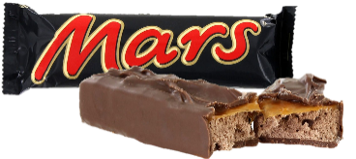
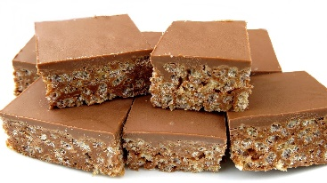
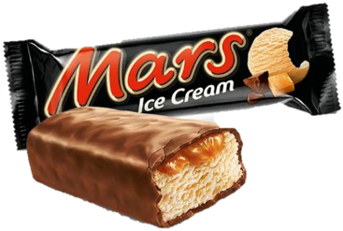
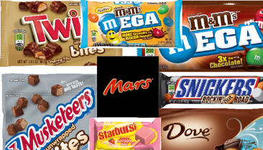
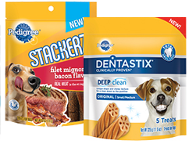
P7.2 – The Benefits Branding Can Generate
Frank C. Mars started making confectionery products in 1911 in the US. His son Forrest came to the UK, rented a factory in Slough in 1932 and invented the Mars Bar. In 1959 advertisers came up with the slogan, 'A Mars a day helps you work, rest and play'. Later it was rebranded with the slogan 'Pleasure you can't measure', designed to attract young, female customers. The company is still family owned.
Extension strategies included smaller 'Fun time' and 'Snack time' bars, sold in multiple packs. Then came the highly successful ice cream bar. The basic recipe is the same today, although the arrange­ment of the component ingredients was changed in 2002. Purist enthusiasts protested vigorously.
Discussion
Why do so many businesses strive to create a recognisable brand? You should be able to state and explain at least three good reasons.
Why do people stay loyal to many of the brands they buy? Explain giving at least three examples of your own.

Slide 12
P7.2 – The Benefits Branding Can Generate
But of course whatever the tangible benefits of the product might be, branding is designed to create an image too, one that suits the buyers in the market segment for which the product is designed. What, would you say, defines the Mars brand?
Brand recognition is usually vastly enhanced by advertising. Product differentiation is important too - brands depend on being recognisably different but branding itself helps to make them so. So it is not surprising that branding is a key element in the marketing mix. Firms spend an extraordinary amount of money on getting their brand right. They target certain markets and sub-sets of markets and devise brands that will be especially likely to appeal within those markets. In fact branding is integral to the marketing effort.
Product placement, sometimes called embedded marketing, means displaying the product in a non-advertising context, e.g. a film or a TV programme or possibly mentioning it in a book. This used to be illegal in the UK but the ban was lifted early in 2011. So now, if you see someone on TV holding a branded product, it may be that the business that owns the brand has paid for that product to be there.

Slide 13
P7.2 – The Benefits Branding Can Generate
Brand names create an identity for the product and highlight the ways in which it is different from competing products.
Brand loyalty refers to the way in which customers will make repeat purchases when they have decided that they prefer the product to others. Some brand loyalty reflects customers' clear preferences, but it can also be a result of inertia. When this happens, the brand's position may be threatened by lively advertising of other products.
A brand might be one product, a range of products or the actual business itself (think of Nike or Adidas). Branding often allows businesses to charge a higher price than those of competing products.
Of course, they will have to work at maintaining the relative desirability of the product; usually this means that they will need to continue advertising throughout the life of the product and they may need to look at 'place' aspects of the marketing mix, to ensure that their product is very visible.
Brands can get involved in aggressive price cutting but this does not often happen.

Slide 14
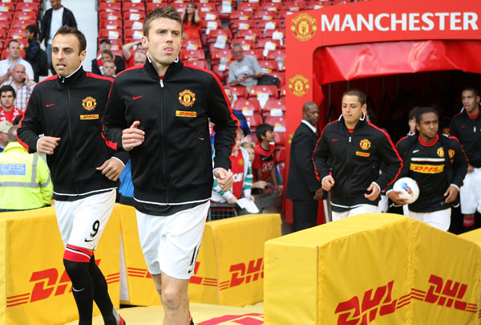
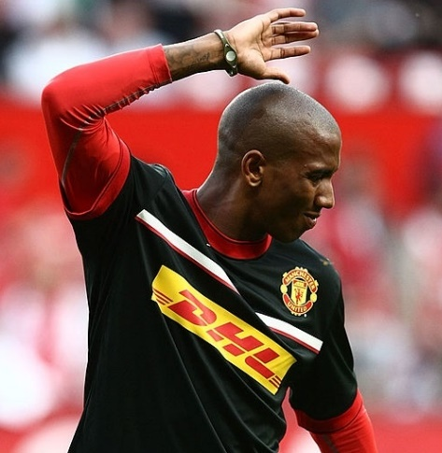
P7.2 – The Benefits Branding Can Generate
In a world where celebrity culture is 'king', businesses pay huge sums of money to celebrities to endorse their brand. But firms have to be wary about what they do with their brand and with whom they wish to be associated. Given the importance of reputation in preserving brand loyalty, mistakes can be costly.
Consider the following three examples:
Manchester United has signed a deal worth £40m over 4 years with DHL, the logistics company, for sponsorship of their training kit - not match day kit. Match day kit is sponsored to the tune of £20m a year by Aon, the US financial giant.
Tiger Woods, the golfer, lost lucrative sponsorship deals with Tag Heuer, the luxury watch brand, and Gillette, among others, as details of his private life hit the headlines. It has been estimated that his sponsors lost revenue of over £2bn as a result of Woods' association with their products.

Slide 15
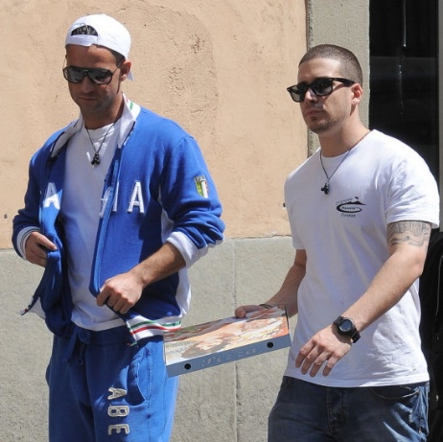
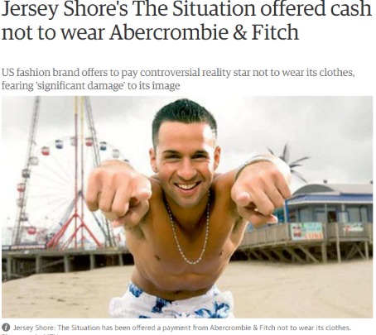
P7.2 – The Benefits Branding Can Generate
Abercrombie & Fitch, an up-market clothing firm are reported to have offered a considerable sum of money to Mike Sorrentino, one of the stars of the MTV reality show Jersey Shore, not to wear its clothes. The show, now in its fourth season, is wildly popular with the young demographic that buy Abercrombie & Fitch clothes.
The company issued a statement saying "We understand that the show is for entertainment purposes, but believe this association is contrary to the aspirational nature of our brand, and may be distressing to many of our fans."

Slide 16
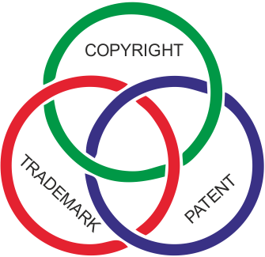
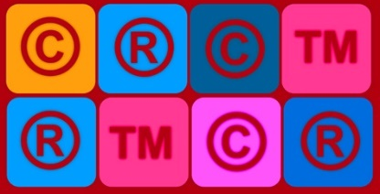
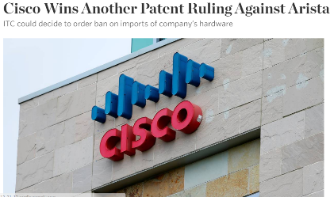
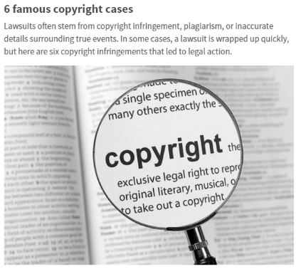
P7.2 – The Benefits Branding Can Generate
A helping hand - patents and trademarks
Many people come into business having previously been employed by someone else in the same line of work. They may feel they have the expertise to do a better job or they may decide to branch out on their own as they have spotted a gap in the market.
However, their ability to research the market may be limited; their ability to carry out research and development (R&D) prior to entering a market may be still more so. The time and finance needed would be very hard to obtain. Many first time entrepreneurs have to develop their ideas in their own time, using their own savings.
In these circumstances it is desperately important for the innovative entrepreneur to be able to protect his or her idea. That 'give and take' may be achieved if the law on preserving the benefits of an invention is firmly in place to reward the inventor and to prevent copying. In the UK the laws on patents and copyright, plus those on trademarks, attempt to do this.

Slide 17
P7.2 – The Benefits Branding Can Generate
Established companies often have R&D departments and are continuously improving
their products and processes, as well as inventing completely new products. They too need an incentive to invest in this way. Their research will give them a competitive advantage but this would not last long if anyone could copy their ideas. It would not be long enough for them to recoup their development costs.
Where a new invention is involved, individuals and businesses can apply to the Intellectual Property Office (IPO) for a patent. (This used to be called the Patent Office.) This will give them twenty years during which no one will be allowed to copy their invention. The IPO often takes two or more years to process the application, but nevertheless, patents do give a considerable degree of protection. For the duration of the patent, its owner will be able to make money from using it in its products or production processes.

Slide 18
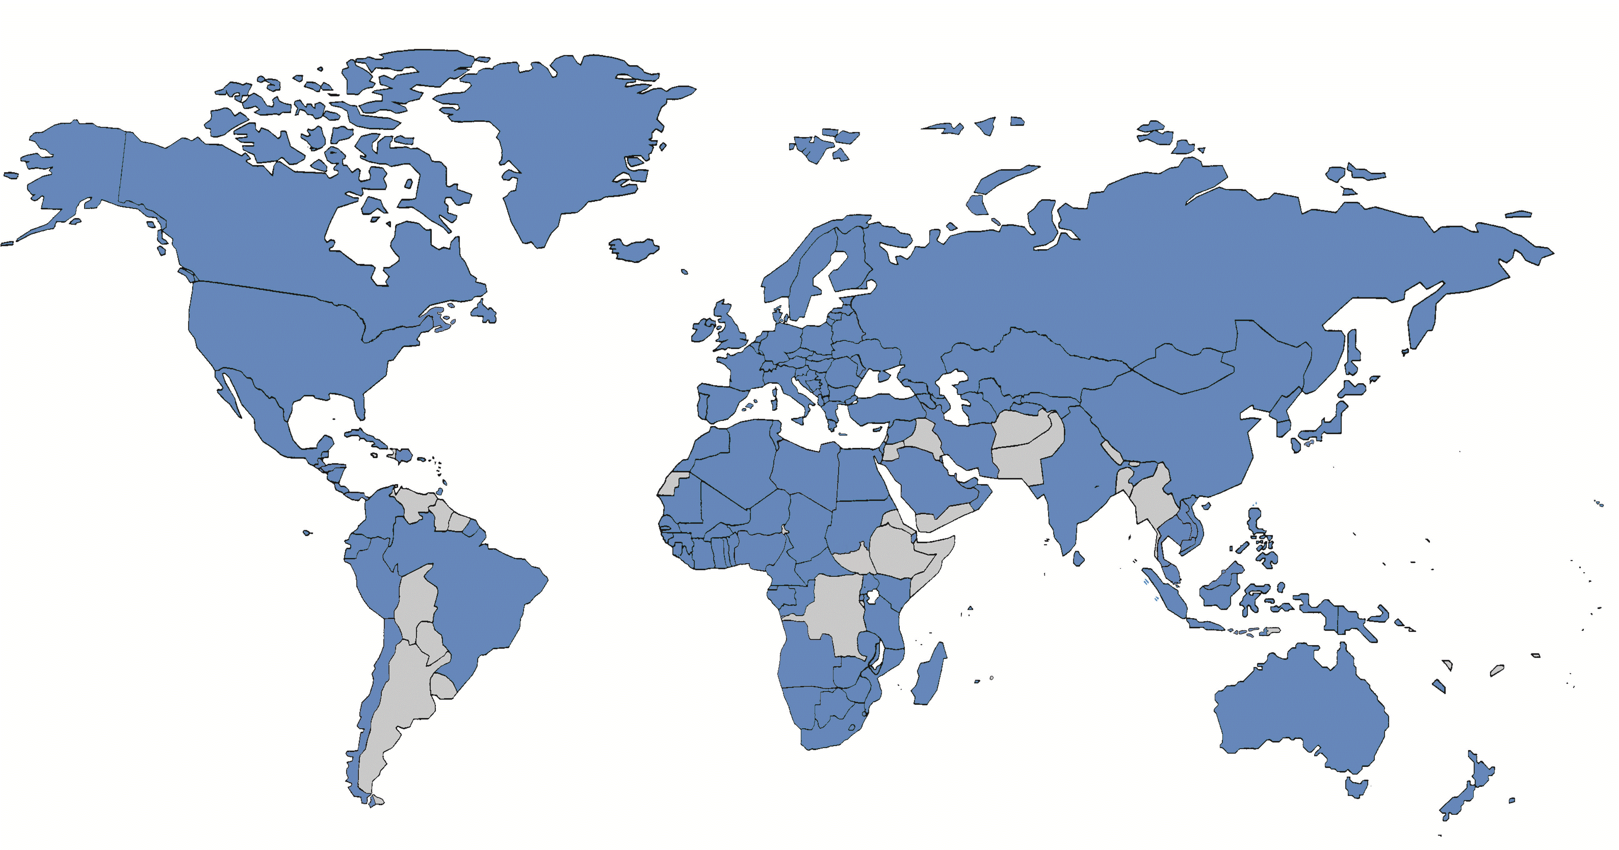
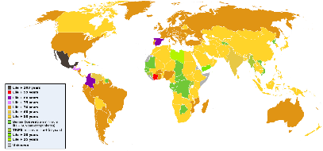
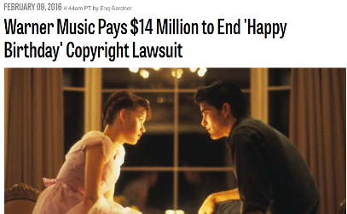
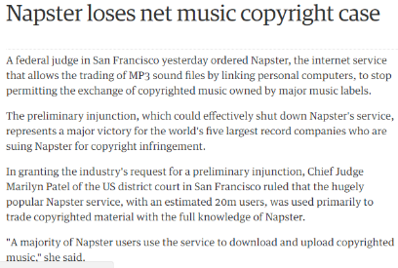
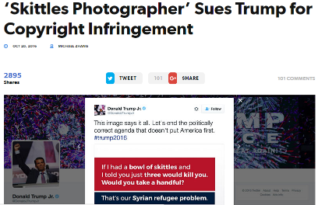
P7.2 – The Benefits Branding Can Generate
In the UK there is a fee of between £230 - £280 for a patent, and after 4 years an annual renewal fee. Notice that patents are granted for new ways of producing, as well as for new products or components. We can distinguish two types of innovation - product innovation where new products are involved, and process innovation where there are new machines or procedures have been developed in order to cut production costs. L'Oreal, next, is all about product innovation.
Patents can be registered internationally. Venture capital funds that support small businesses that have come up with an exciting invention expect international patents to be in place before they provide finance. Businesses that want to copy an invention during the life of the patent will have to find a new and different way of designing and making it.

Slide 19
P7.2 – The Benefits Branding Can Generate
A patent protects the functionality of a product in terms of how it works and its application. Once granted, the patent gives the owner the right to prevent others from producing, importing or selling their invention, without prior permission. The owner of the patent will be able to sue anyone who infringes it in the courts.
Many people come into business having previously been employed by someone else in the same line of work. They may feel they have the expertise to do a better job or they may decide to branch out on their own as they have spotted a gap in the market.
Product innovation involves inventing or designing new or improved products, such as Dyson's bladeless fan.
Process innovation involves the use of new technologies in the production process and may play a big part in cutting costs. Robots are just one example.
P7.2 – Task 02 – In a report, describe for INK what they have done to create brand recognition and unique selling points, and to represent their beliefs and values.

Slide 20
LO4 – Assessment Tasks
P7.1 - Task 01 – In a report, describe with examples what Branding is and the benefits to companies of doing it.
P7.2 – Task 02 – In a report, describe for INK what they have done to create brand recognition and unique selling points, and to represent their beliefs and values.

